Slide 1




Sindh University Job Portal
Project ID
SU/FET/IT/FYP/2022/08
Group Members:
Fahad Ali Jamali 2K19/IT/30 | Iqra Chahar 2K19/IT/45 | Nigam Qureshi 2K19/IT/88| Supervised By:
Zeeshan Bhatti

Slide 2
TABLE OF CONTENTS
INTRODUCTION
01
Online registration of enrollment and exam procedure of BISE MirpurKhas
SCOPE OF PROJECT
02
TOOLS AND TECHNOLOGY
03
AIMS & OBJECTIVES
04

Slide 3
TABLE OF CONTENTS
PROPOSED METHODOLOGY
05
Steps to achieve agile development and our Online Registration of Enrollment and Exam Procedure
ANAYLSIS & DESGIN PROGRESS TIMELINE
06
RESULTS
Results obtained from our project
07
REFERENCES
08
references

Slide 4
1. INTRODUCTION
Online registration of enrollment and exam procedure of BISE MirpurKhas”. Is our system it is designed to automate the system of BISE from manual paper work and reduce the redundancy of data of a student and fill the enrollment and exam form of student through online by registration and generate slips for exam
which comes in paperwork and creates efficiency and fast enrollments of students in BISE, and slips generated easily which gives ease to the student and the workers of BISE

Slide 5
2. SCOPE OF PROJECT
This project will help to reduce manual paperwork. It's easy-to-use and there's nothing to install
Enrolling Student:
First of all the student enroll his self with his complete information and then login to see his/her dashboard panel.
Latest News:
Student can see the latest updated of BISE MirpurKhas which the admin have given and check the due dates of exams and download challan of exam.
Admin Area:
Admin login through his information check enrollments, add schools and update the exam form due dates
Admin Generate Slips:
Admin off the due date of exam and then generate the slips of student by class series wise.
Student Contact Form:
In main page the student have any query so they can contact, and admin will reply it.

Slide 6





React JS
Tailwind CSS
Express JS
MySQL
3. TOOLS AND TECHNOLOGY

Slide 7



Visual Studio Code
Postman
PhpMyAdmin
3. TOOLS AND TECHNOLOGY

Slide 8
5.METHODOLOGY
WE USE WATERFALL METHODOLOGY
The waterfall model is a classical model used in system development life cycle to create a system with a linear and sequential approach. It is termed as waterfall because the model develops systematically from one phase to another in a downward fashion.

Slide 9
5.METHODOLOGY
WE USE WATERFALL METHODOLOGY
The waterfall model is a classical model used in system development life cycle to create a system with a linear and sequential approach. It is termed as waterfall because the model develops systematically from one phase to another in a downward fashion.

Slide 10
System Design

Slide 11

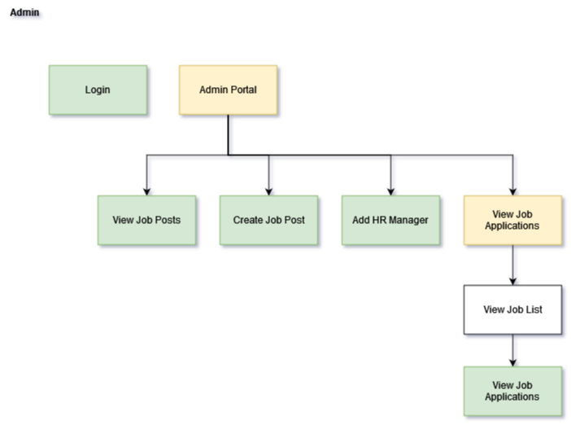
Progress Overview
UI

Slide 12
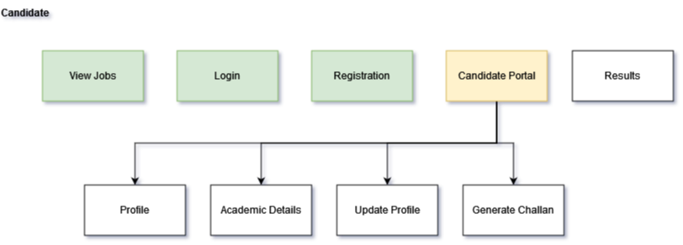
Progress Overview
UI

Slide 13
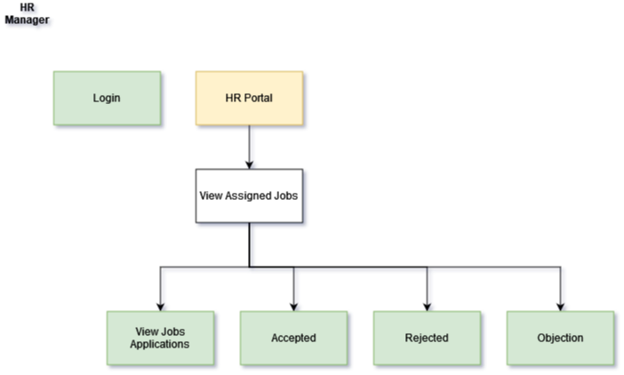
Progress Overview
UI

Slide 14
Progress Overview
Back-end Functionality
Candidate
1. Registration
2. Login
3. Academic Details
4. Slip Generation
5. Apply

Slide 15
Progress Overview
Back-end Functionality
HR Manager
1. Registration
2. Login
3. Accept Applications
4. Reject Applications
5. Objections on Application
6. View Result
a. Select Candidates for interview

Slide 16
Progress Overview
Back-end Functionality
Admin
1. Login
2. Create Job Post
3. Add HR Manager
4. Update Job Post
5. Update HR Manager Details
6. Activate/Deactivate Job Post and HR Manager

Slide 17
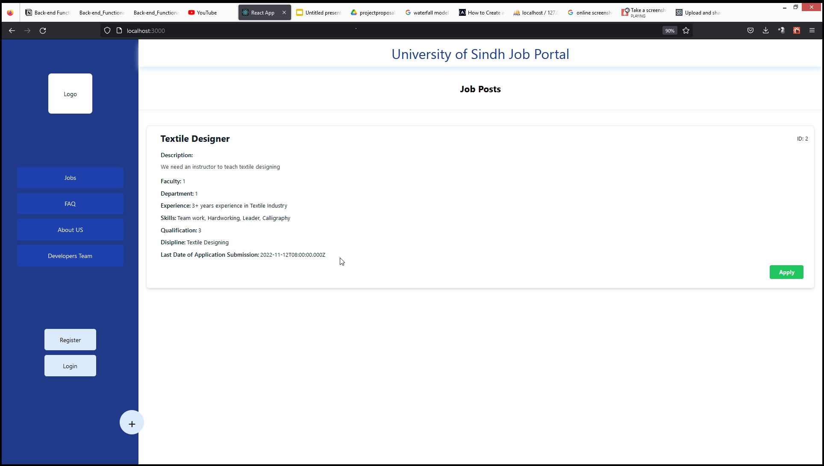
6. Prototype Design
Home Page

Slide 18
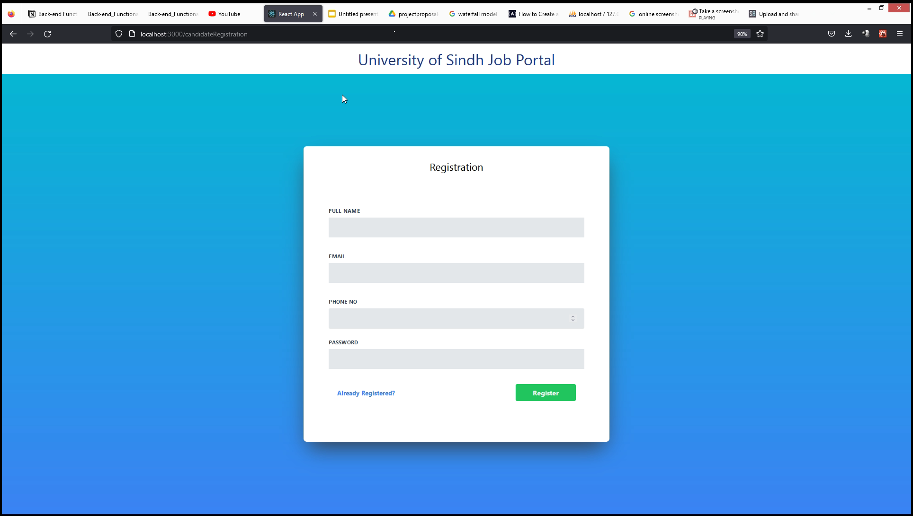
6. Prototype Design
2. Candidate Registration Page

Slide 19
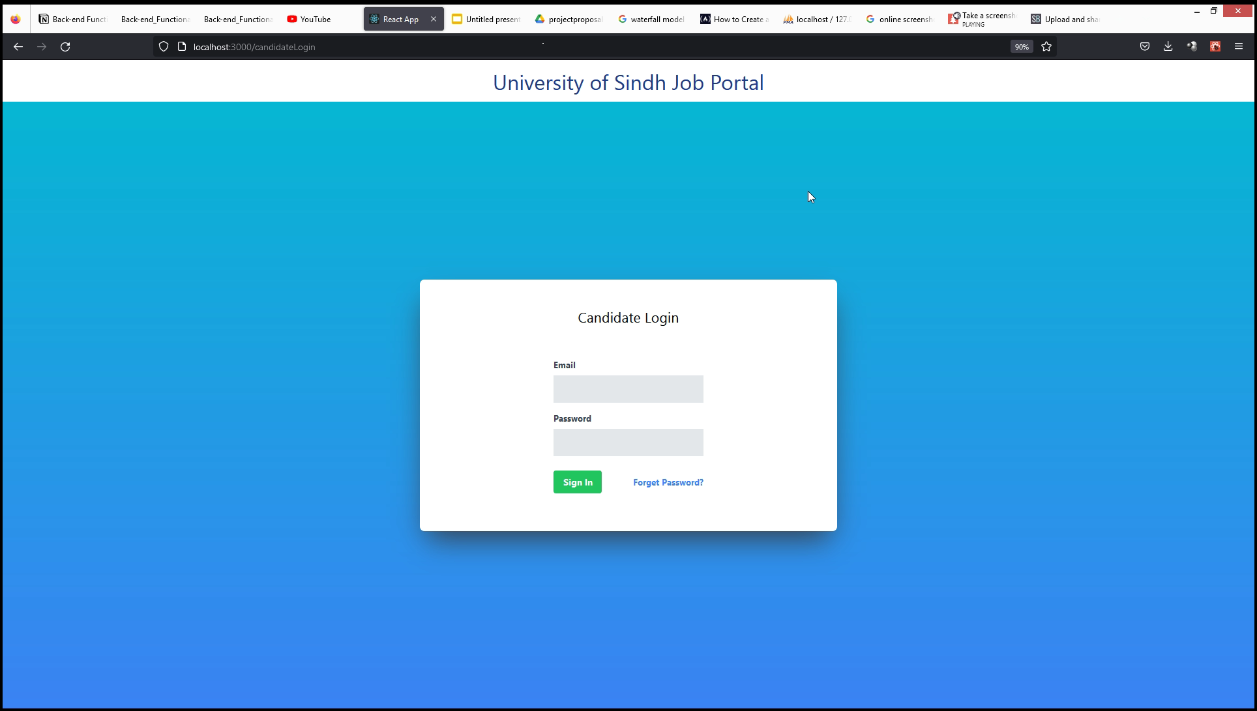
6. Prototype Design
3. Login Page

Slide 20
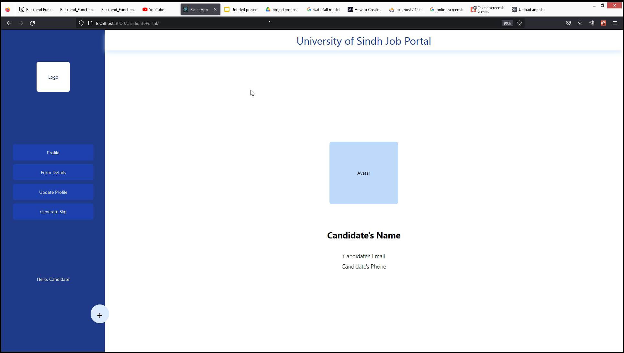
6. Prototype Design
4. Candidate Profile in Candidate Portal

Slide 21
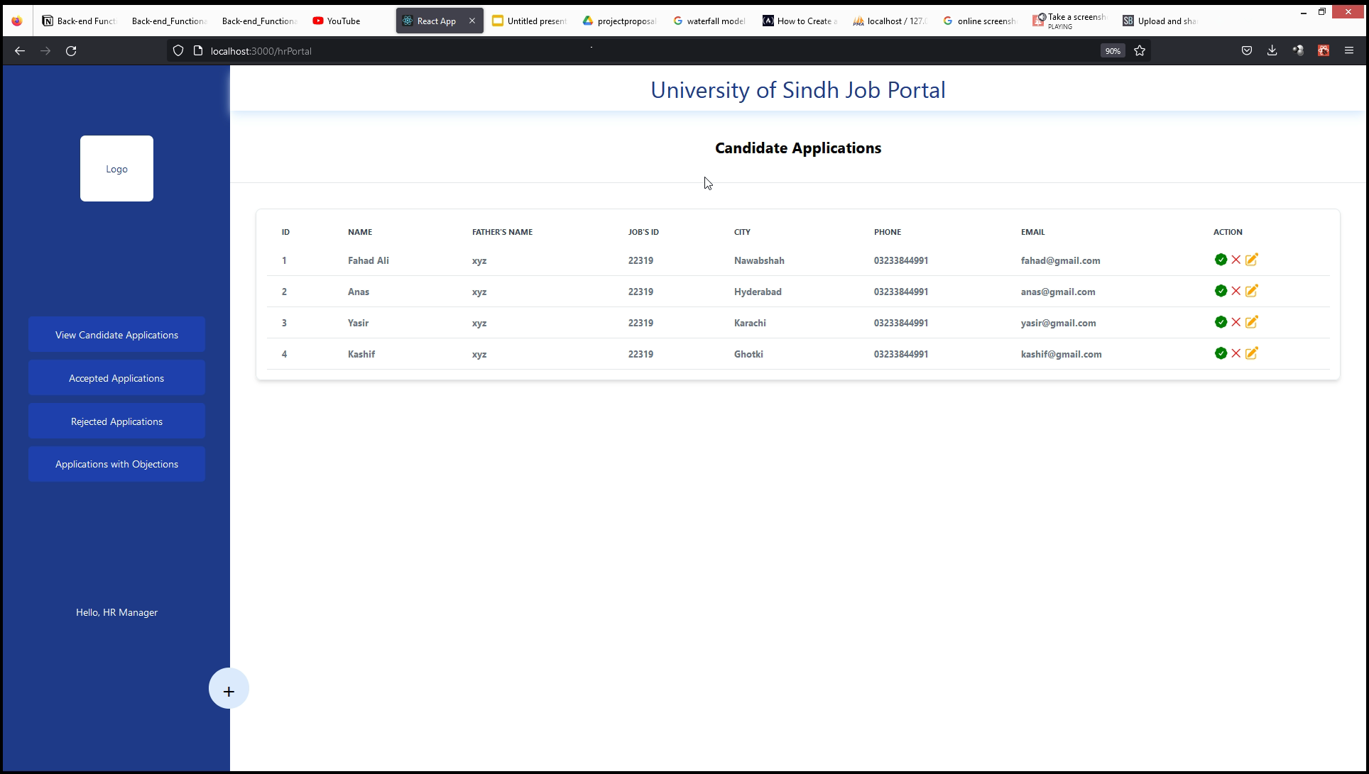
6. Prototype Design
5. View Job Applications in HR Portal

Slide 22

6. Prototype Design
6. View Accepted Applications in HR Portal

Slide 23

6. Prototype Design
7. View Rejected Applications in HR Portal

Slide 24
6. Prototype Design
8. View Applications with Objection in HR Portal

Slide 25
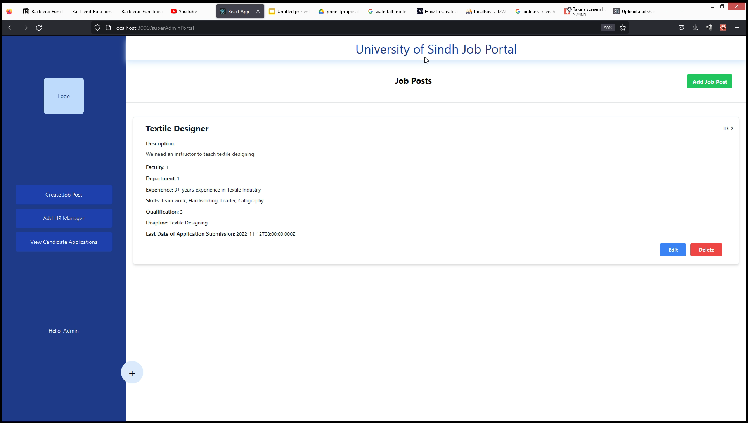
6. Prototype Design
9. View Jobs in Admin Portal

Slide 26
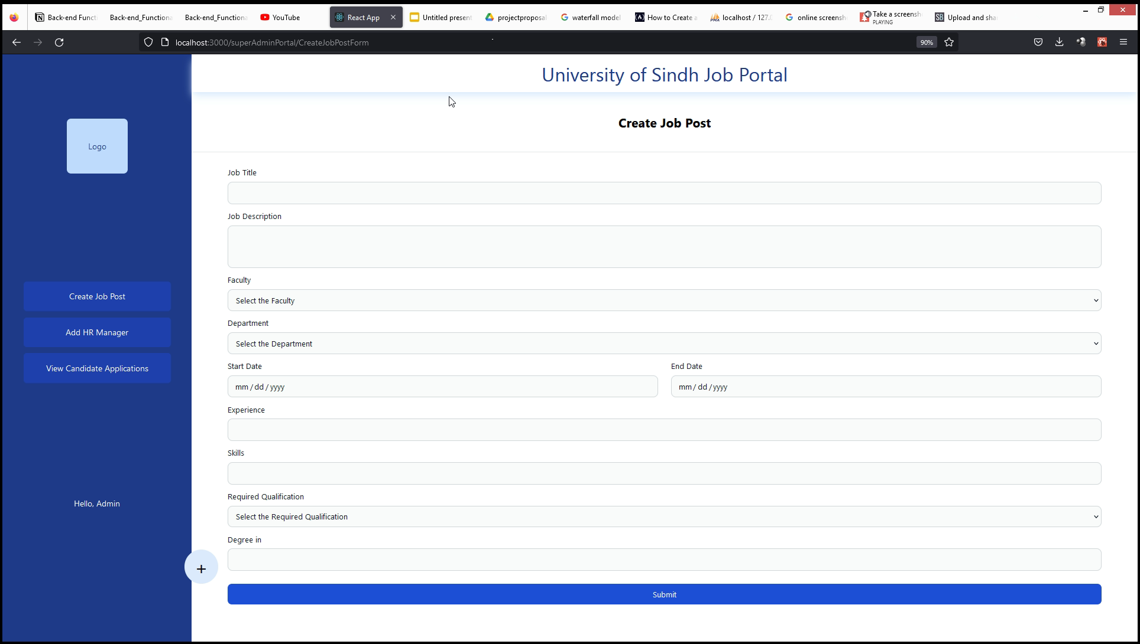
6. Prototype Design
10. Create Job Post in Admin Portal

Slide 27
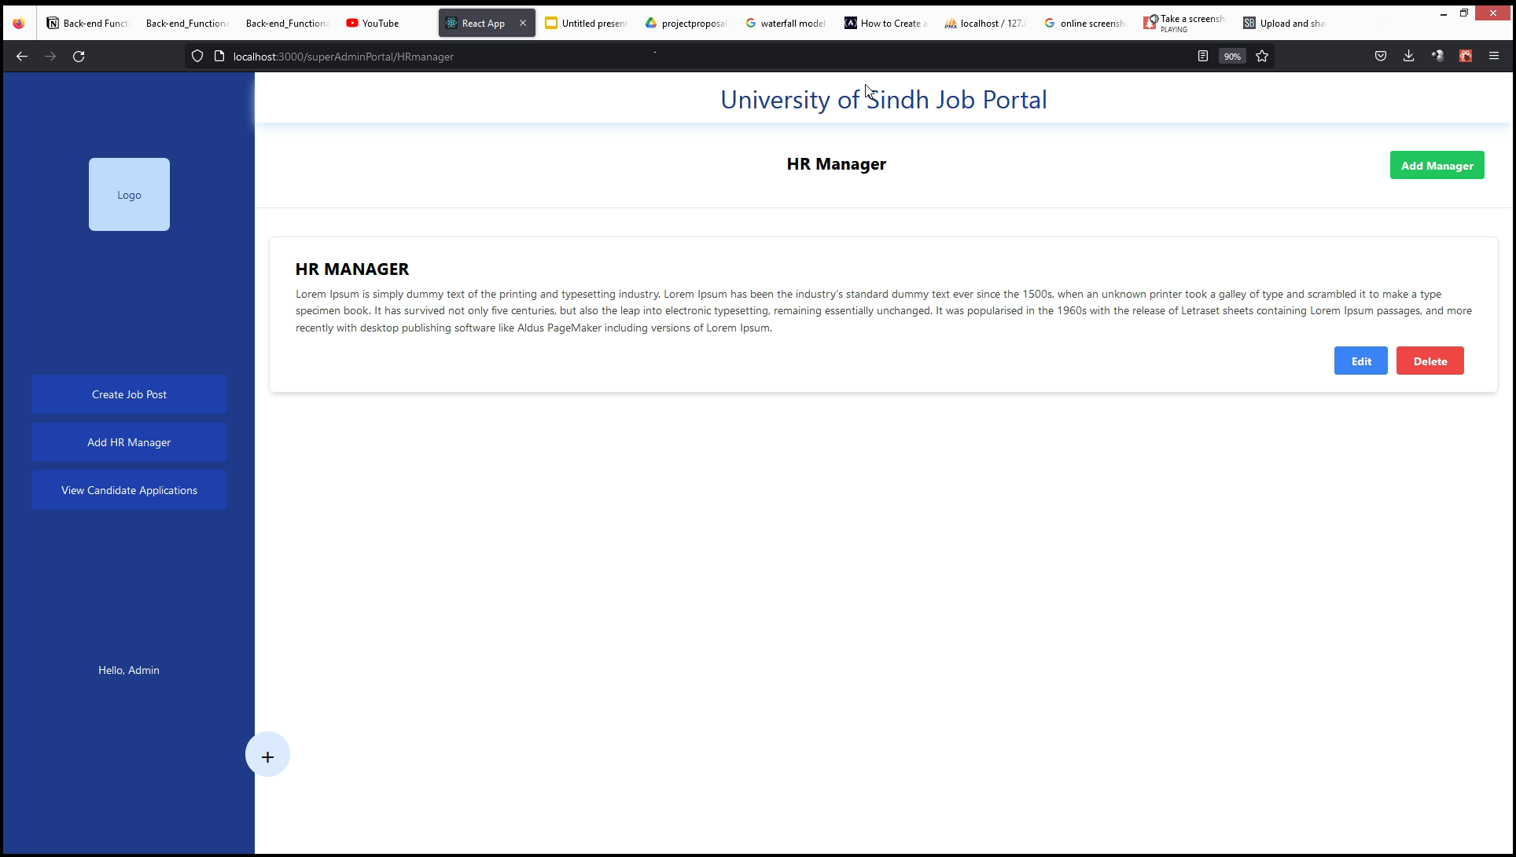
6. Prototype Design
11. View HR Managers in Admin Portal

Slide 28
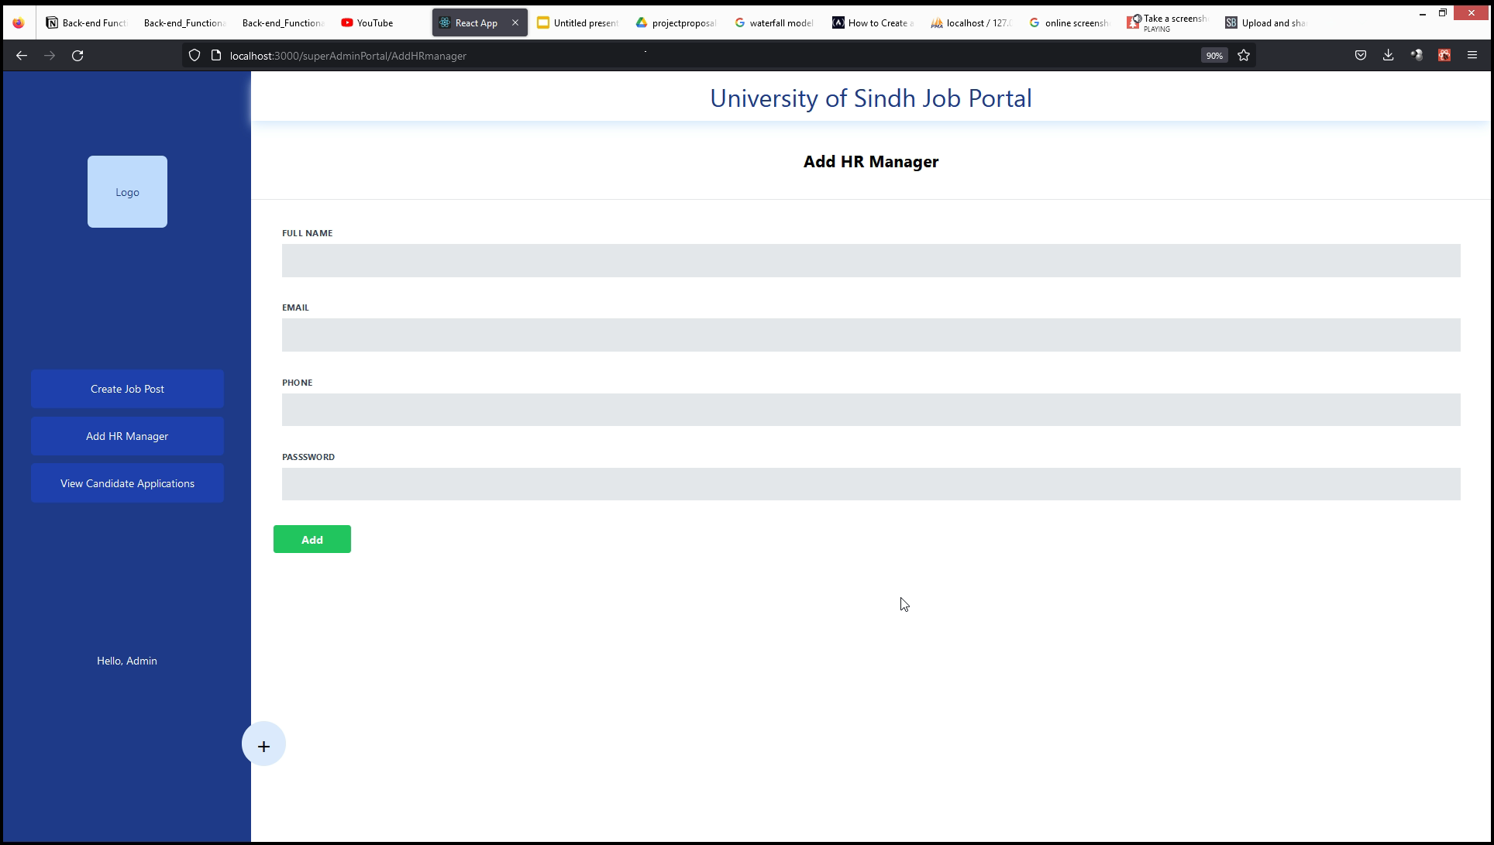
6. Prototype Design
12. Add HR Manager in Admin Portal

Slide 29
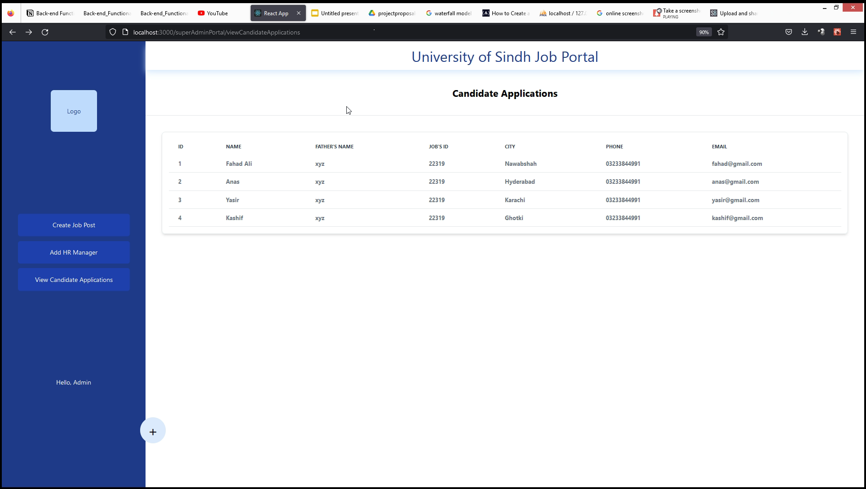
6. Prototype Design
13. View Candidate Applications in Admin Portal

Slide 30
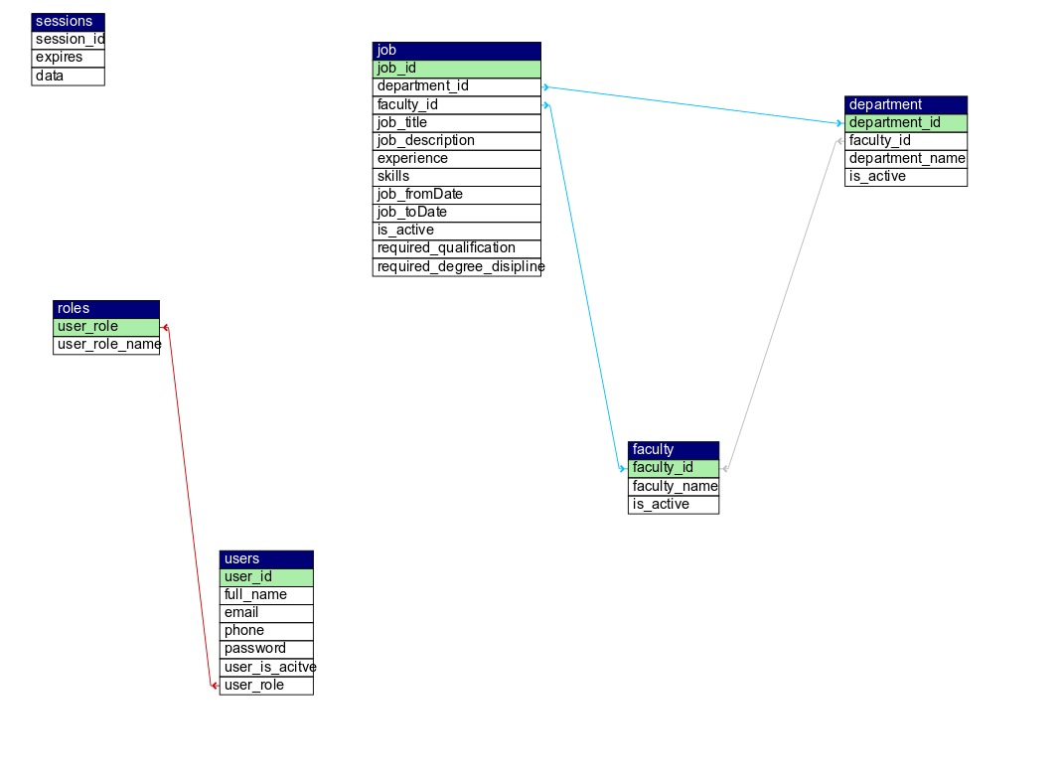
ER Diagram

Slide 31
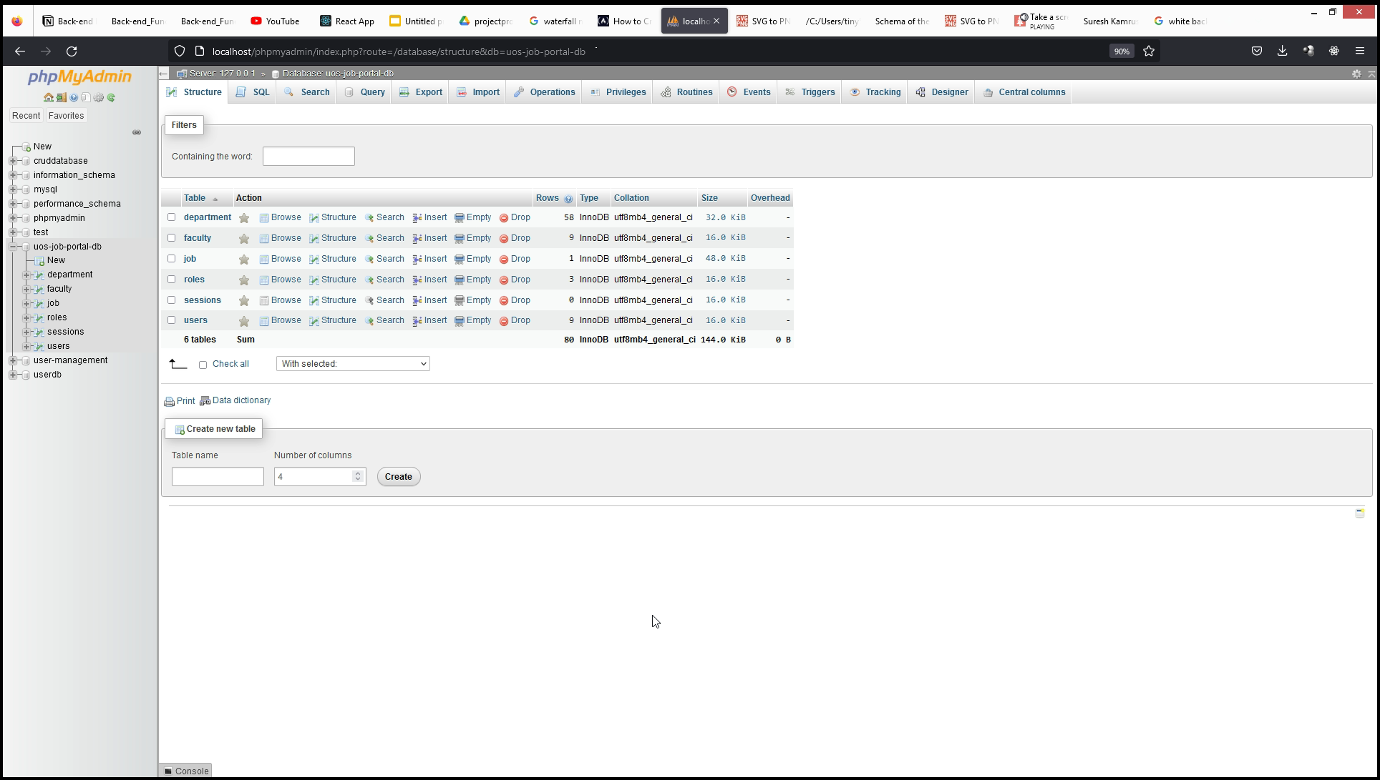
UoS Job Portal DB in phpMyAdmin

Slide 32
Thank you

